Slide 1
Canonical Correlation Analysis

Slide 2
What is “Canonical” Correlation
Maximize correlation between two sets of variables
Variables might not have dependent-independent variable relationship
Example: correlation between exercise and health. 2 sets, each with multiple variables.
Set 1: Exercise ~ Running speed, push-ups per minute, weight lifting, etc.
Set 2: Health ~ Body mass index, blood pressure, heart rate, etc.
Useful when number of dimensions in dataset is large (similar to PCA except):
PCA maximizes variance
CCA maximizes correlation

Slide 3
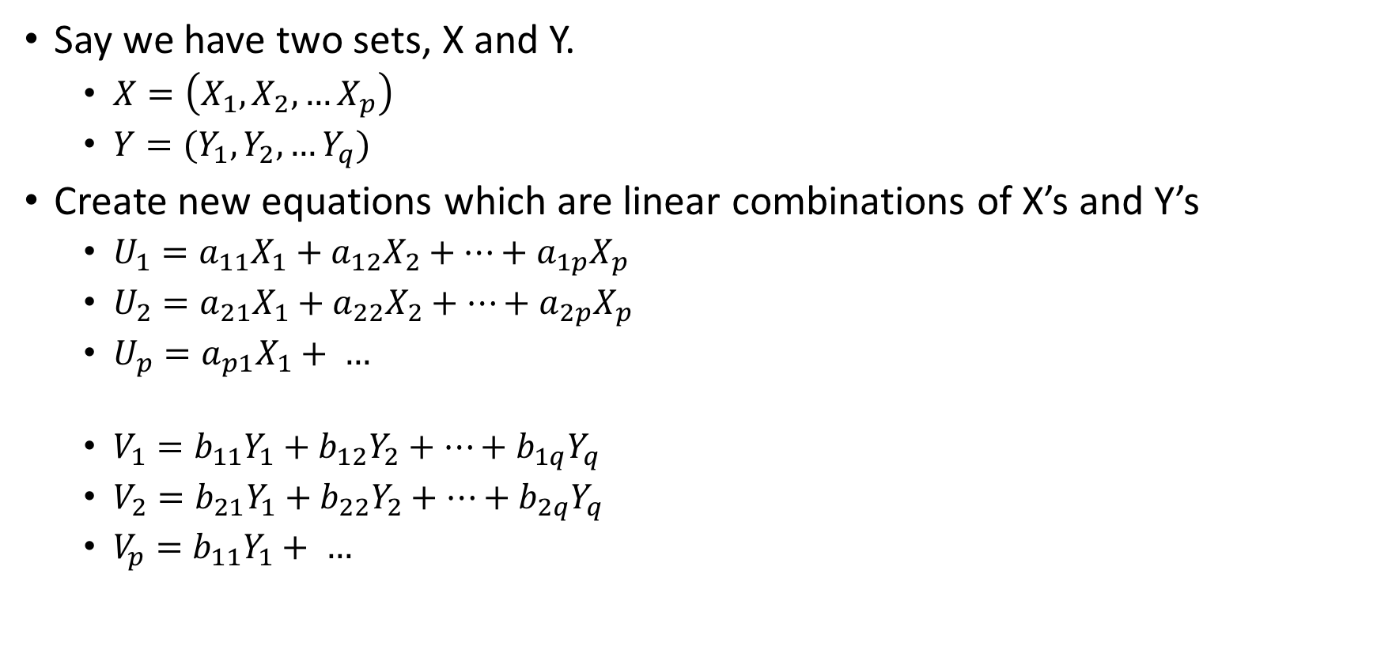
Say we have two sets, X and Y.
$X=\left(X_{1}, X_{2}, …X_{p}\right)$
$Y=(Y_{1}, Y_{2}, …Y_{q})$
Create new equations which are linear combinations of X’s and Y’s
$U_{1}=a_{11}X_{1}+a_{12}X_{2}+…+a_{1p}X_{p}$
$U_{2}=a_{21}X_{1}+a_{22}X_{2}+…+a_{2p}X_{p}$
$U_{p}=a_{p1}X_{1}+ …$
$V_{1}=b_{11}Y_{1}+b_{12}Y_{2}+…+b_{1q}Y_{q}$
$V_{2}=b_{21}Y_{1}+b_{22}Y_{2}+…+b_{2q}Y_{q}$
$V_{p}=b_{11}Y_{1}+ …$

Slide 4
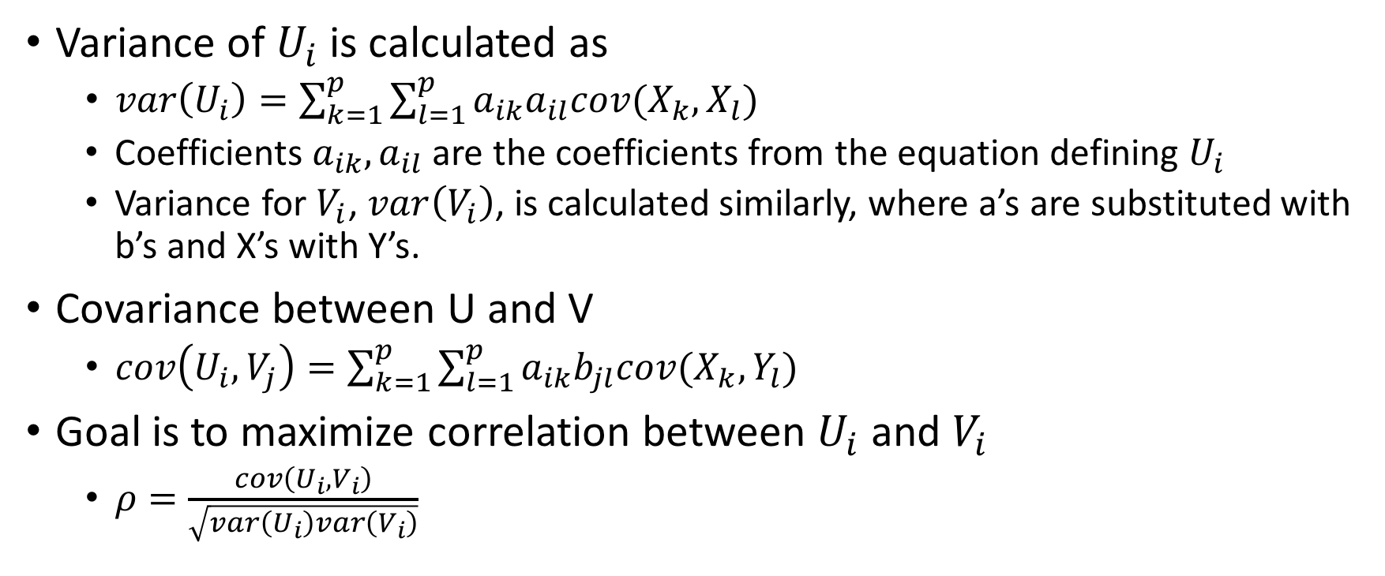
Variance of $U_{i}$ is calculated as
$var\left(U_{i}\right)=\sum_{k=1}^{p}{\sum_{l=1}^{p}{a_{ik}a_{il}cov(X_{k},X_{l})}}$
Coefficients $a_{ik}, a_{il}$ are the coefficients from the equation defining $U_{i}$
Variance for $V_{i}$, $var\left(V_{i}\right)$, is calculated similarly, where a’s are substituted with b’s and X’s with Y’s.
Covariance between U and V
$cov\left(U_{i}, V_{j}\right)=\sum_{k=1}^{p}{\sum_{l=1}^{p}{a_{ik}b_{jl}cov(X_{k},Y_{l})}}$
Goal is to maximize correlation between $U_{i}$ and $V_{i}$
$ρ=\frac{cov\left(U_{i}, V_{i}\right)}{\sqrt{var\left(U_{i}\right)var\left(V_{i}\right)}}$

Slide 5
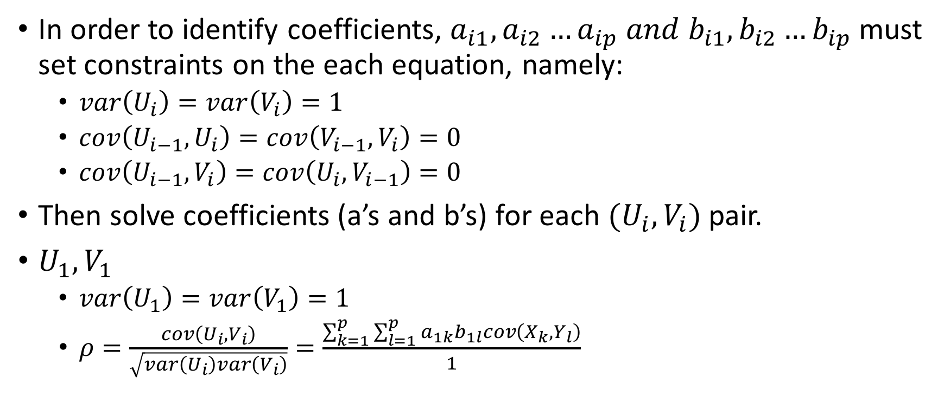
Implementation
In order to identify coefficients, $a_{i1},a_{i2}…a_{ip} and b_{i1},b_{i2}…b_{ip}$ must set constraints on the each equation, namely:
$var\left(U_{i}\right)=var\left(V_{i}\right)=1$
$cov\left(U_{i−1}, U_{i}\right)=cov\left(V_{i−1},V_{i}\right)=0$
$cov\left(U_{i−1}, V_{i}\right)=cov\left(U_{i},V_{i−1}\right)=0$
Then solve coefficients (a’s and b’s) for each $(U_{i}, V_{i})$ pair.
$U_{1},V_{1}$
$var\left(U_{1}\right)=var\left(V_{1}\right)=1$
$ρ=\frac{cov\left(U_{i}, V_{i}\right)}{\sqrt{var\left(U_{i}\right)var\left(V_{i}\right)}}=\frac{\sum_{k=1}^{p}{\sum_{l=1}^{p}{a_{1k}b_{1l}cov\left(X_{k},Y_{l}\right)}}}{1}$

